Slide 1

Mapping Recommendations to A* algorithms
Sl.Number | Student Name | USN | Roll Number | Division
1 | Abhijna R Kalbhag | 01FE21BCS107 | 116 | A
2 | Shreya Pai | 01FE21BCS089 | 215 | B
Guide: Prof. Prakash Hegade

Slide 2
Index
Introduction
Problem statement
Research Question
Initial Design
Implementation Status
Reference

Slide 3
Introduction
In this project,we are trying to map recommendations to a grid data structure and apply A* algorithm over it for better results. The aim is to address the limitations of traditional recommendation approaches, such as sparsity [1]and lack of nuance, by providing a structured and efficient method for capturing user preferences and item characteristics. By mapping recommendations to a grid, the system can incorporate user-item interactions, item features, and contextual information, leading to more accurate and personalized recommendations. The A* algorithm aims to improve recommendation quality by finding optimal paths through the recommendation grid.

Slide 4
Problem Statement
To design and implement recommendation mapping to a relevant grid data structure and application of A* algorithm.

Slide 5
Research Question
How does the grid data structure compare to traditional recommendation approaches in terms of recommendation quality, computational efficiency, and scalability?

Slide 6
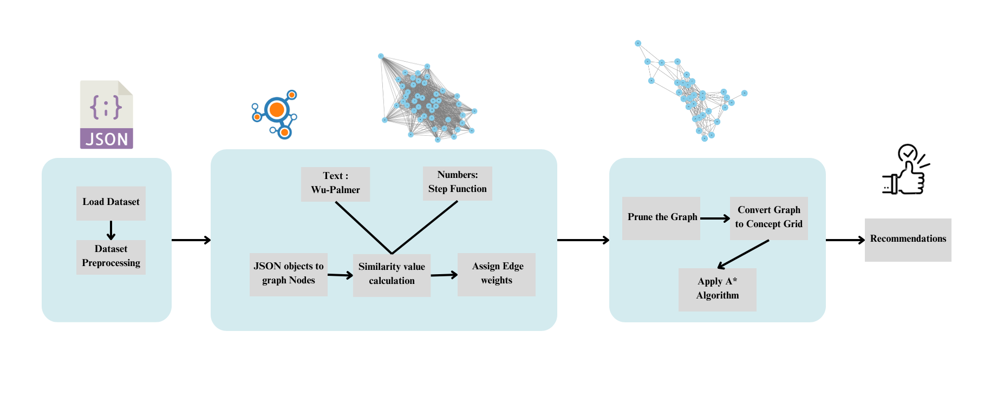
System Design

Slide 7
What Next?
Item grid Creation
Application of A* Algorithm

Slide 8
Reference
[1] Roy, Deepjyoti, and Mala Dutta. "A systematic review and research perspective on recommender systems." Journal of Big Data 9.1 (2022): 59.
[2]https://amazon-reviews-2023.github.io/

Slide 9
Thank You

Slide 10
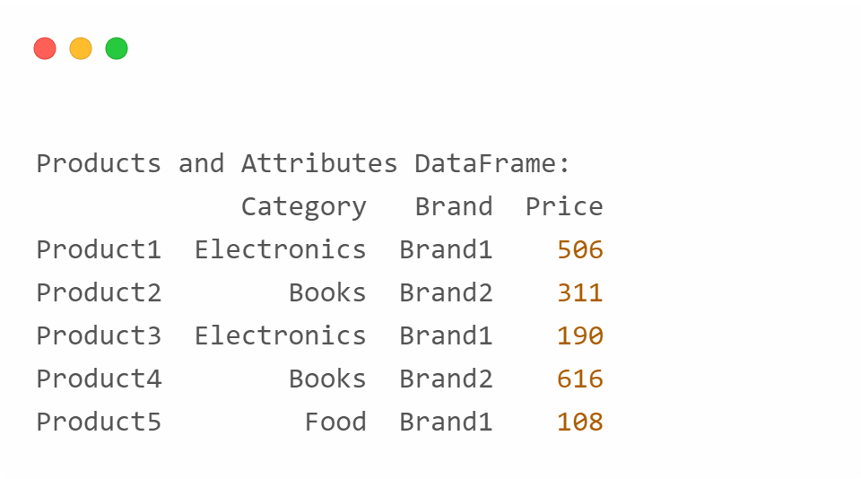
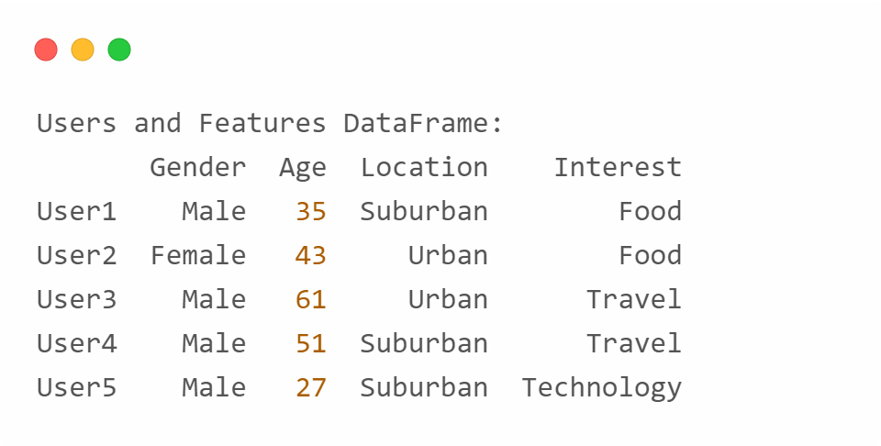
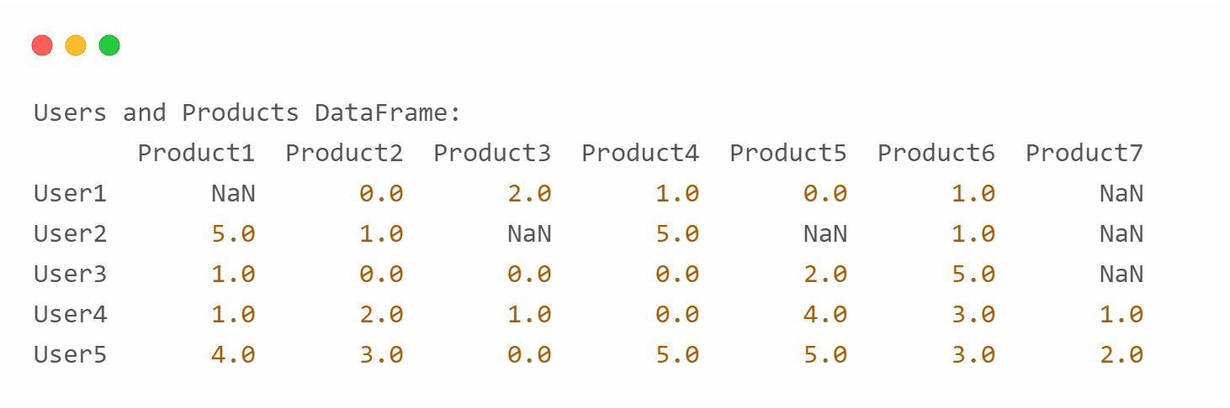
Implementation Status
We have identified 3 kinds of possible grid structures for a recommendation system

